Slide 1
Regression Analysis
Vaseem Durrani

Slide 2
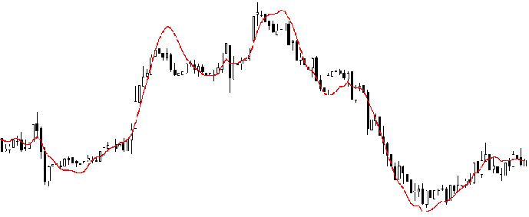
REGRESSION ANALYSIS
Regression in machine learning consists of mathematical methods that allow data scientists to predict a continuous outcome (y) based on the value of one or more predictor variables (x).
Linear Regression is probably the most popular form of regression analysis because of its ease-of-use in predicting and forecasting.

Slide 3
Example: Wants to predict next week's temperature
The temperature to be predicted depends on different properties such as humidity, atmospheric pressure, air temperature and wind speed
But how accurate are your predictions?
How good is your algorithm?
VARIANCE: Variance is the amount by which the estimate of the target function changes if different training data were used. To avoid false predictions, we need to make sure the variance is low.
BIAS : Bias is the algorithm’s tendency to consistently learn the wrong thing by not taking into account all the information in the data. For the model to be accurate, bias needs to be low.

Slide 4
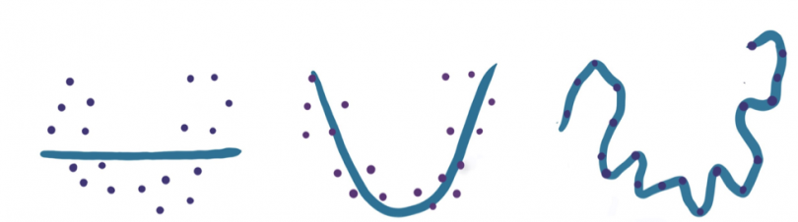
Model Performance
UnderFitting
Ideal
OverFitting

Slide 5
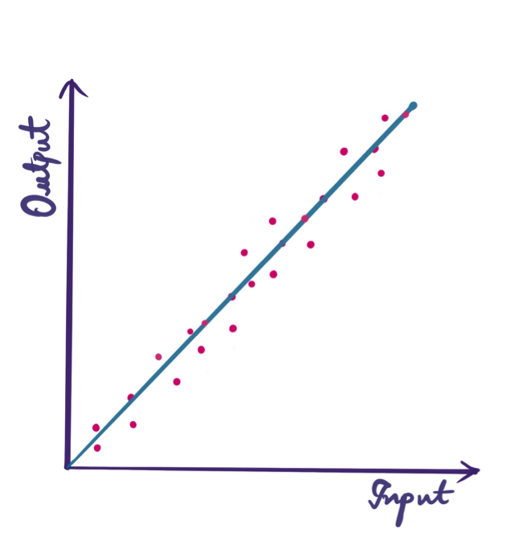
Linear Regression
Linear regression finds the linear relationship between the dependent variable and one or more independent variables using a best-fit straight line.
You have given a set of data and your goal is to draw the best-fit line which passes through the data.
This is the step-by-step process you proceed with:
Consider your linear equation to be y = mx+c, where y is the dependent data and x is the independent data given in your dataset.
Adjust the line by varying the values of m and c, i.e., the coefficient and the bias.
Come up with some random values for the coefficient and bias initially and plot the line.
Since the line won’t fit well, change the values of ‘m’ and ‘c.’ This can be done using the ‘gradient descent algorithm’ or ‘least squares method’.

Slide 6
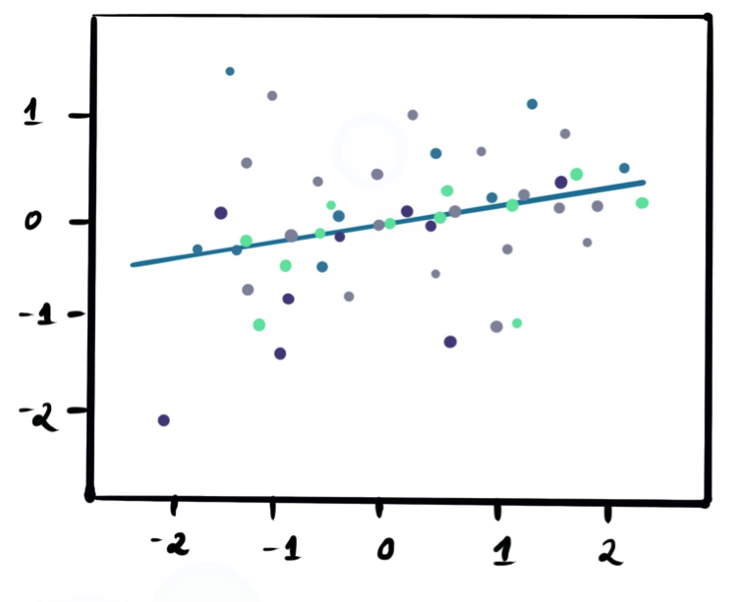
Simple Linear Regression
Simple linear regression is one of the simplest (hence the name) yet powerful regression techniques. It has one input (“x”) and one output variable (“y”) and helps us predict the output from trained samples by fitting a straight line between those variables.
Y = mX+c
Y - Dependent Variable
X - Independent Variable
m – slope ( Coefficient)
C – intercept (bias)

Slide 7
Multiple Linear Regression
This is similar to simple linear regression, but there is more than one independent variable. Every value of the independent variable x is associated with a value of the dependent variable y. As it’s a multi-dimensional representation, the best-fit line is a plane.
Mathematically, it’s expressed by:
y = b0 + b1X1 + b2X2 + b3X3

